Slide 1
Cell Viability TRAMP-C1 Cells Treated with Curcumin, Isoliquiritigenin or Liquiritigenin (MTS)
Davit Sargsyan, 05/16/2016

Slide 2
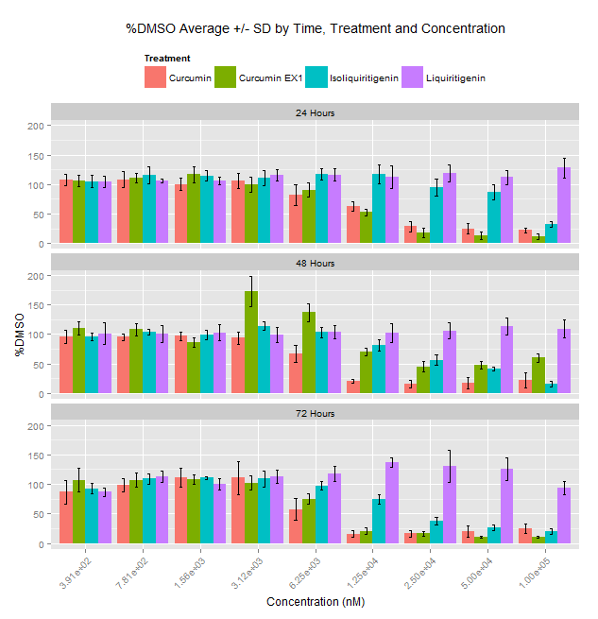
Barplot with Error Bars: %DMSO Average +/-SD

Slide 3
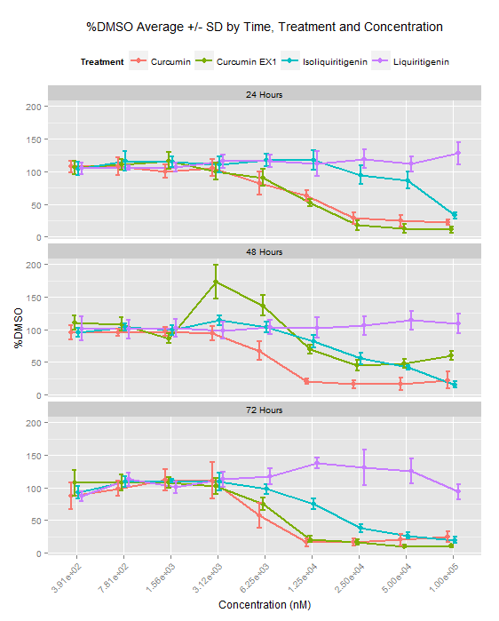
Line plot with Error Bars: %DMSO Average +/-SD
Curve | IC50 with 95% C.I. (μM)
Experiment1: Curcumin 24 Hours | 11.23(9.84, 12.81)
Experiment2: Curcumin 24 Hours | 11.59(8.89, 15.12)
Experiment1: Curcumin 48Hours | No convergence
Experiment2: Curcumin 48 Hours | 6.82(5.77, 8.05)
Experiment1: Curcumin 72 Hours | 7.53(6.84, 8.28)
Experiment2: Curcumin 72 Hours | No convergence
Experiment2 Isoliquiritigenin 24 Hours | 189.51(0.12, 307767.19)
Experiment2 Isoliquiritigenin 48 Hours | 28.48(17.74, 45.74)
Experiment2 Isoliquiritigenin 72 Hours | 15.09(12.24, 18.6)
Experiment2 Liquiritigenin24 Hours | No convergence
Experiment2 Liquiritigenin 48Hours | No convergence
Experiment2 Liquiritigenin 72 Hours | No convergence

Slide 4
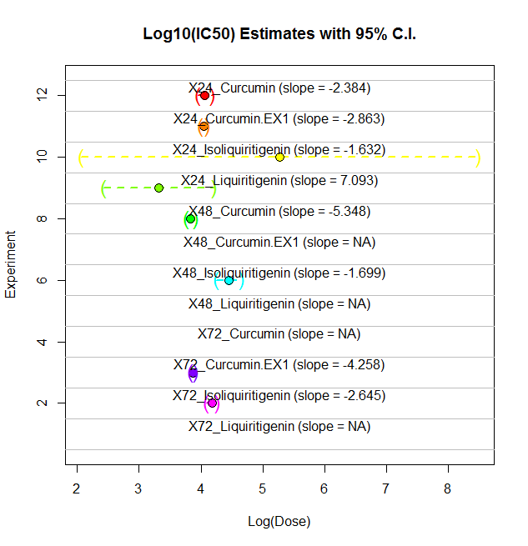

Slide 5
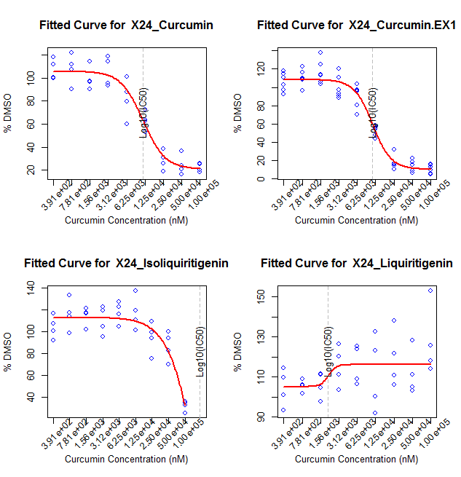
24 Hours

Slide 6
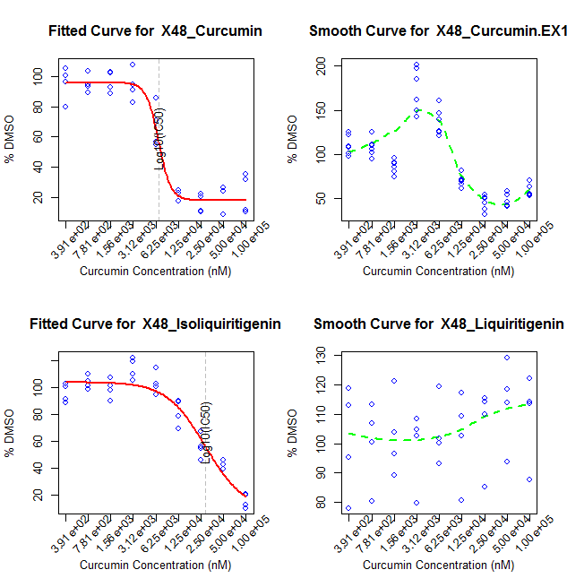
48 Hours

Slide 7
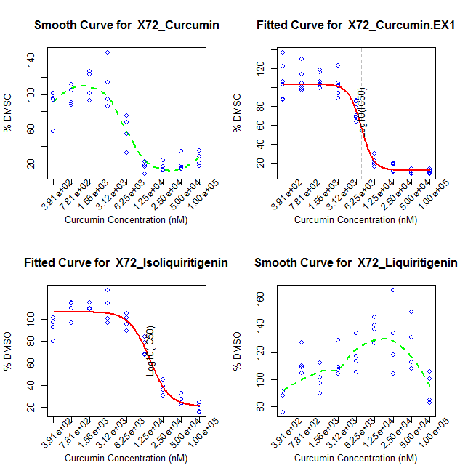
72 Hours

Slide 8
Discussion
Did not re-dose at 48 Hour (ran out of LIQ).
Hook effect was observed at low doses. A model that can describe the hook might be more appropriate, especially if the hook effect becomes more pronounced.
Starting dose for ISO (100 μM) was too low. As a result, I missed bottom part of the curve. Starting concentration needs to be at least X16 of that (X20 = 2 mM)
Starting dose for LIQ (100 μM) was too low. As a result, I only observed the upper part of the curve. No estimate of starting concentration can be obtained from the data.

